Slide 1





PRESENTATION 2026
From Data Chaos To Clarity: Inventory Fulfillment Analysis
Mentor Name
Student Name
Student Email
Umamaheshwari
Prachi Palkar
prachiii1856@gmail.com

Slide 2

Outline
Abstract of the Project
Problem Statement
Proposed Solution
System Architecture
Live Demo of the Project
Embedded Video of Project
Conclusion
Future Scope

Slide 3
Abstract
This project focuses on transforming raw inventory and order fulfillment data into meaningful insights using Microsoft Excel and Power BI.
The main objective is to clean and analyze data to improve inventory management and business decision making.
The dataset contains issues such as duplicate records, missing values, and inconsistent categories, which are corrected using Excel data cleaning techniques and create an interactive dashboard using PowerBI to get business insights.
The final outcome helps businesses track stock levels, monitor order fulfillment, and improve operational efficiency.

Slide 4

Problem Statement
No visibility of best-selling vs least-selling products
High risk of stockouts (300+ low stock items identified)
Overstocking in low-demand products (e.g., Laptop Bags)
Lack of clarity on top-performing categories (Electronics dominates)
High number of cancelled orders affecting revenue (148 orders)
Poor tracking of order fulfillment stages
Inefficient decision-making due to lack of central dashboard

Slide 5

Proposed Solution
Dashboard to identify top products (Bluetooth Speaker, Marker Set)
Detect least-selling products for inventory reduction
Monitor low stock items (<150 units) for timely restocking
Category analysis showing Electronics as highest revenue driver
Track order status (Delivered, Cancelled, Processing, Shipped)
Improve delivery efficiency using delivery days analysis (2–4 days avg)
Use KPI cards for real-time business monitoring

Slide 6
System Architecture
Data Input / Source
Processing / Analysis
Excel dataset from Kaggle
Contains: Order ID, Product Name, Category, Stock levels, Order status, etc.
Removing duplicates: Remove Duplicates tool Handling missing values: Find & Replace
Data validation: Conditional Formatting, Pivot Tables, Sorting & Filtering, Basic Excel formulas
AI / Tool Integration
Output / Dashboard
Microsoft Excel → Data cleaning & analysis
Power BI → Data visualization & dashboard creation
Interactive dashboard: KPI cards, Slicers, Stacked area chart, Narrative, Donut chart, Table, Gauge, Funnel, Question answer, Decomposition tree and Scatter chart

Slide 7
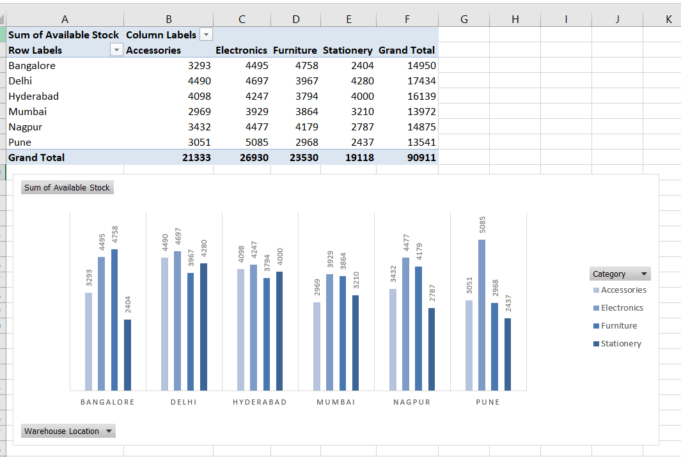
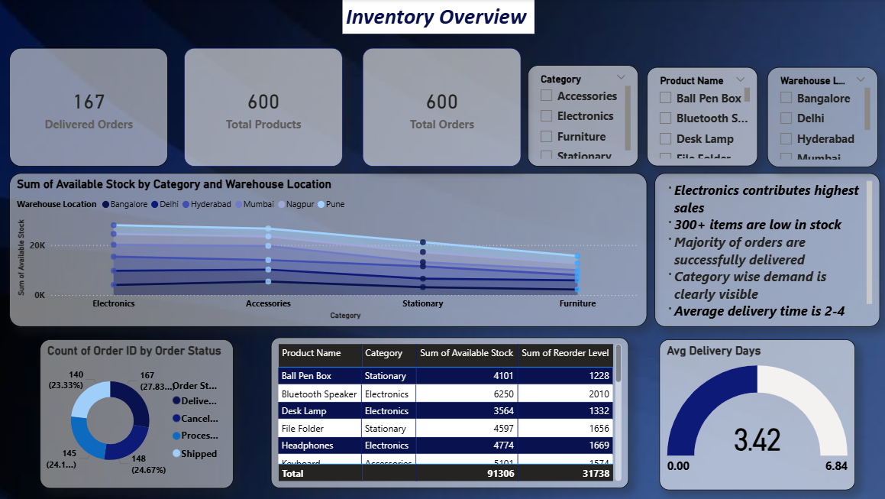
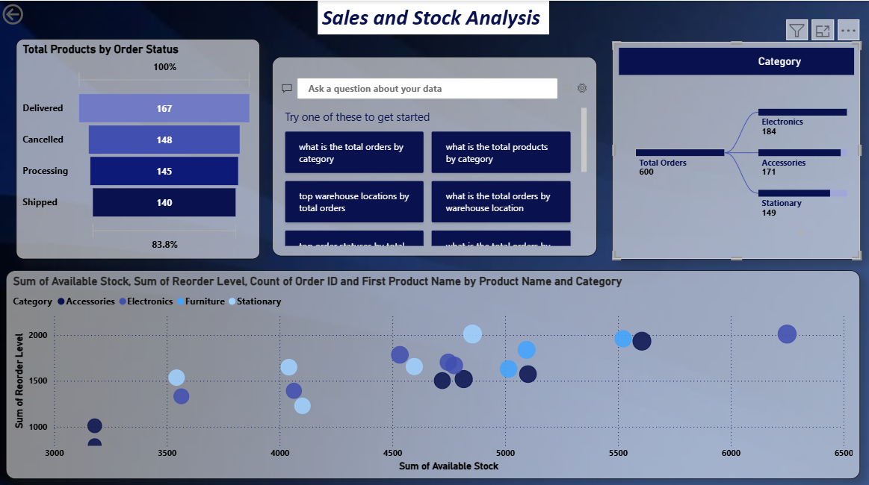
Live Demo of Project
Here's the list of some demo screenshots / features of the project:
Demo 1
Demo 2
Demo 3
[Add description of Demo 1 here — what this demo shows, key features, and results achieved.]
[Add description of Demo 2 here — what this demo shows, key features, and results achieved.]
[Add description of Demo 3 here — what this demo shows, key features, and results achieved.]

Slide 8
Video of Project Demo
https://1drv.ms/v/c/2c8d2e84d8c69fd0/IQBOo2Xgq53QQ574NrnjT_9mAYJ6YckFP0o5tLw2UyKdazc?e=iGparf
▶
[Insert your project demo video.
You can embed a video your live project.]

Slide 9

Conclusion
Identified high-demand and low-demand products clearly
Improved inventory planning (reduce stockouts & overstocking)
Highlighted Electronics as top-performing category
Exposed issue of high order cancellations impacting business
Enabled better order tracking and delivery performance
Dashboard provides quick and actionable insights
Successfully converted data into business value and decisions
CONCLUSION

Slide 10

Future Scope
Integration with live databases
Automation using Power BI refresh
Advanced dashboards with more KPIs
Integration with business systems
Expansion to larger datasets

Slide 11
Thank You
AICW Fellowship | Student Project Presentation 2026
LinkedIn | Edunet Foundation

